Slide 1
Models to Schema & Normal Form Refinement
Adapted from Chapter 14 (Connolly & Begg)

Slide 2
ER Process
To make an ER model from a verbal description you need to identify
Entities
Attributes
Relationships
Multiplicity
Where to start
General guidelines
Since entities are things or objects they are often nouns in the description
Attributes are facts or properties, and so are often nouns also
Verbs often describe relationships between entities

Slide 3
Conceptual model (ER) steps
Identify entity types
Identify relationship types
Identify and associate attributes with entity or relationship types
Determine attribute domains
Determine candidate, primary, and alternate key attributes
Consider use of enhanced modeling concepts (optional step)
Validate conceptual model against user transactions
Review conceptual data model with user

Slide 4
Logical database design for the relational model
Derive relations for logical data model
Validate relations using normalization
Validate relations against user transactions
Define integrity constraints

Slide 5
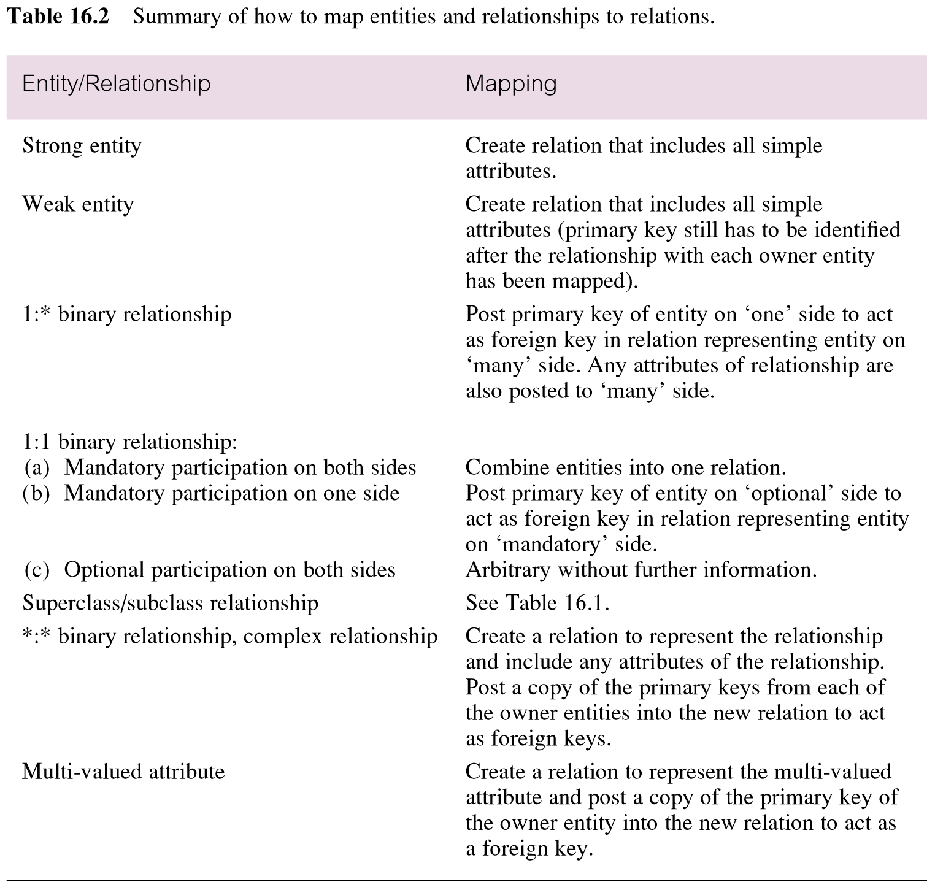
UML Model to Relational Schema

Slide 6
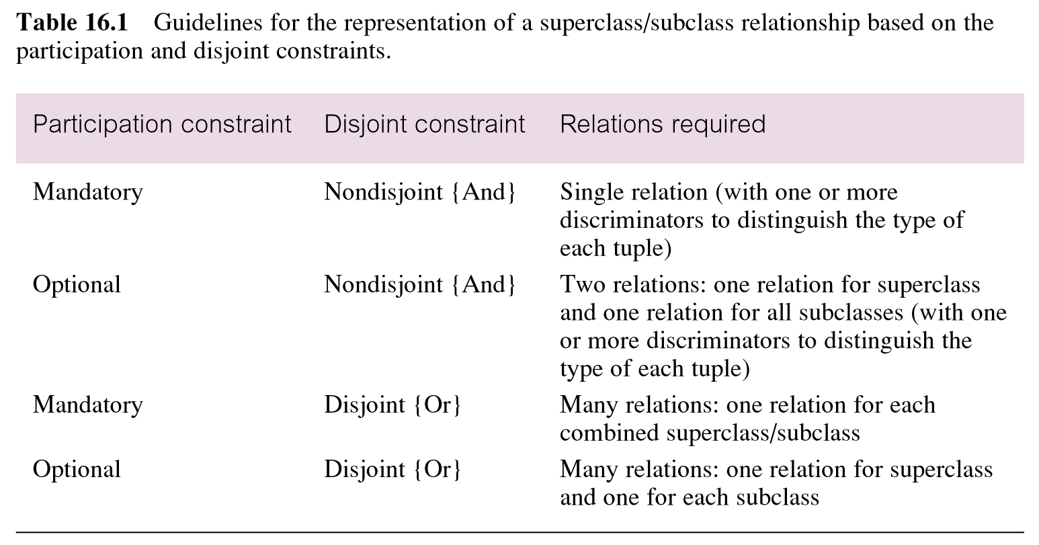
Representation of superclass / subclass relationship

Slide 7
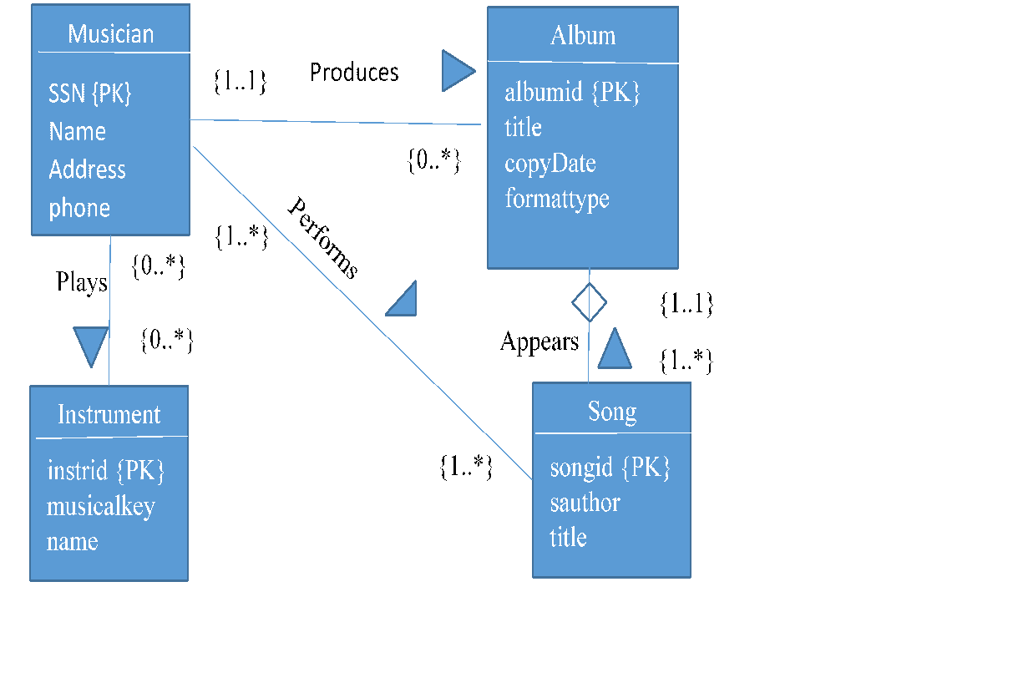
Classwork: Convert UML to a relational schema
Notes:
List the CREATE table commands - Identify the tables, constraints,
CREATE TABLE musician
CREATE TABLE instrument
CREATE TABLE album
CREATE TABLE song
CREATE TABLE performs
CREATE TABLE musiciantoinstrument

Slide 8
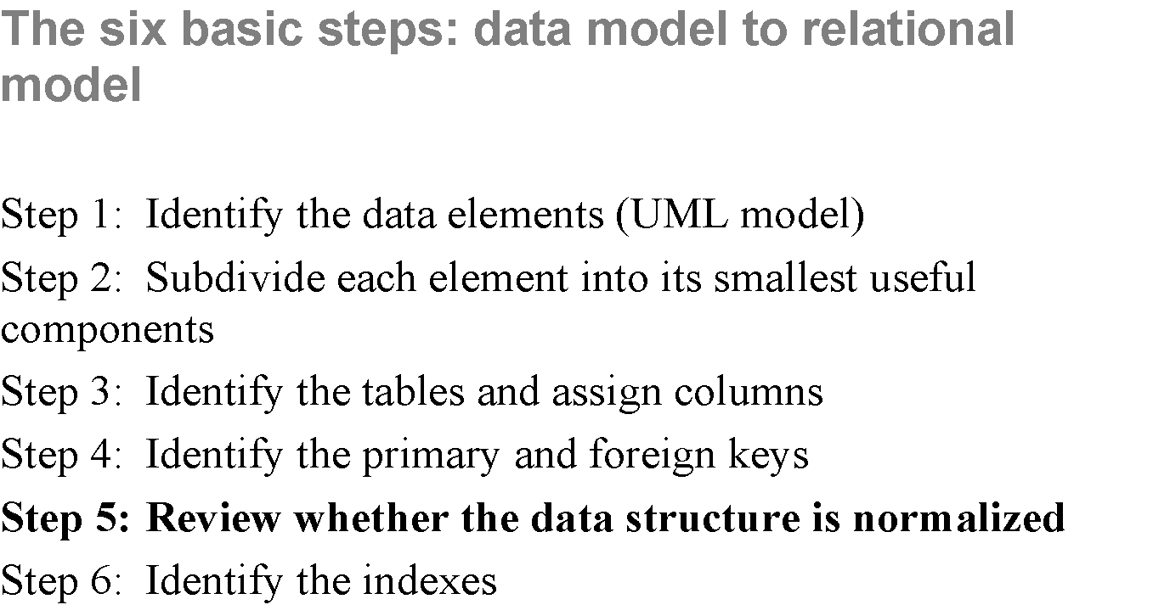

Slide 9
SCHEMA REFINEMENT

Slide 10
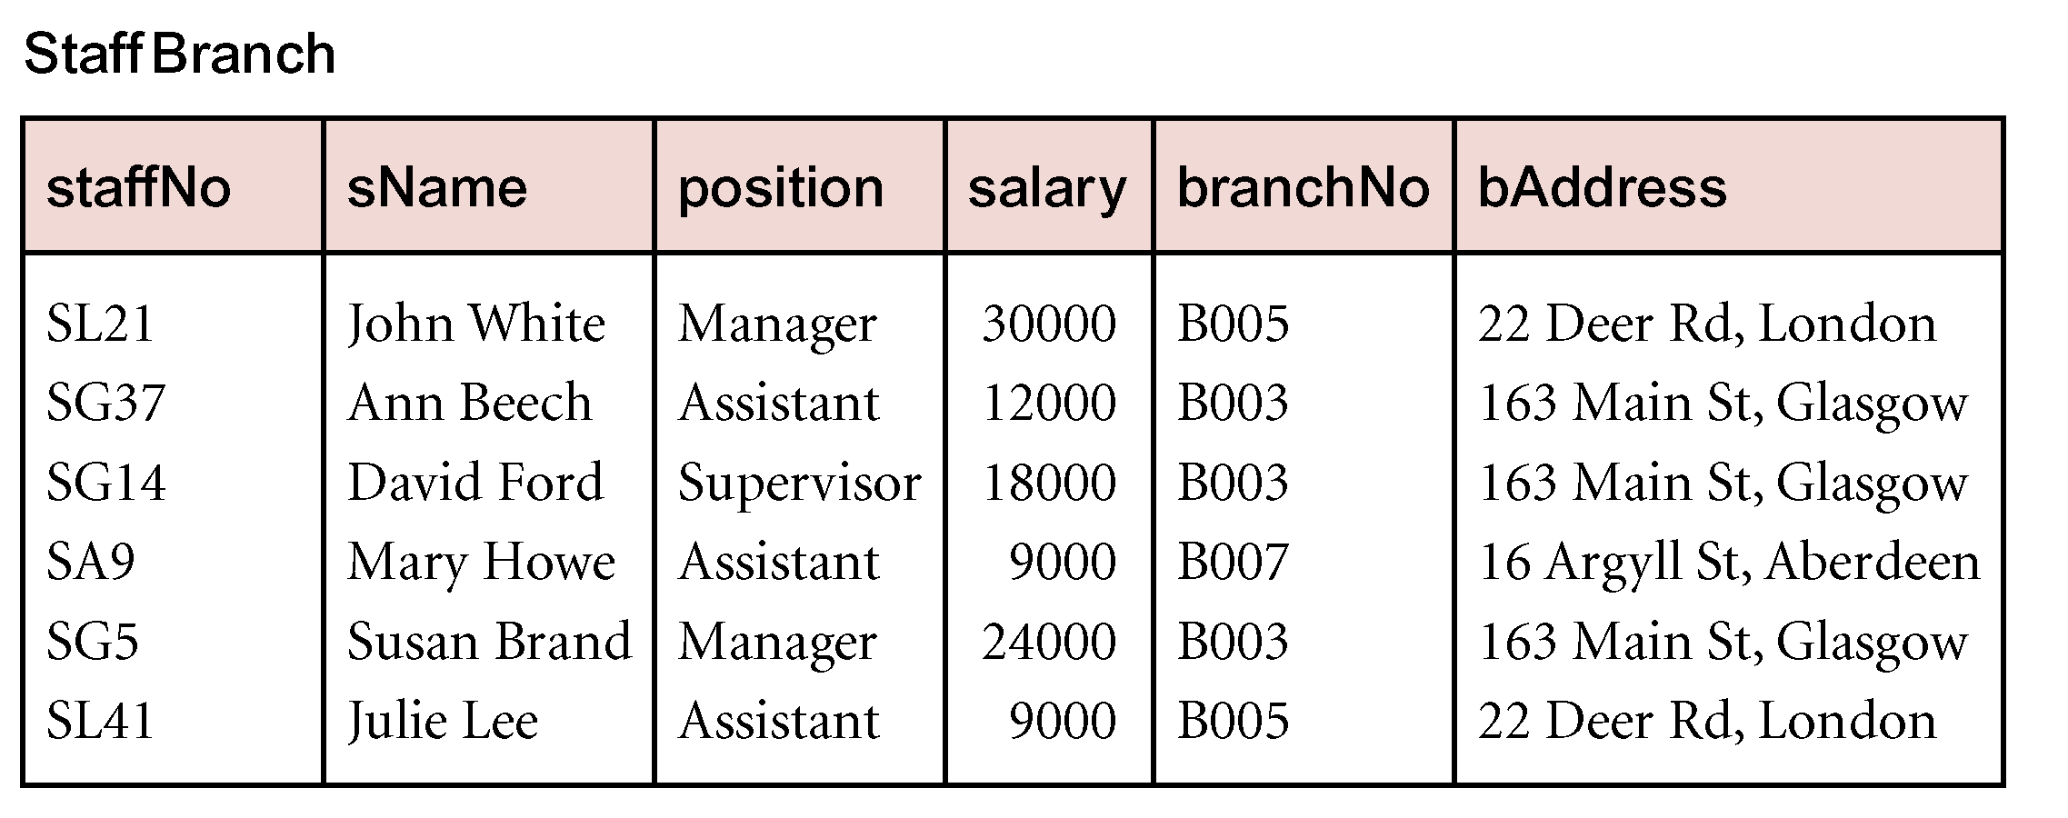
What’s wrong with this table?
Data redundancy of the the branch data

Slide 11
Data Redundancy and Update Anomalies
Relations that contain redundant information may potentially suffer from update anomalies.
Types of update anomalies include
Insertion
Deletion
Modification

Slide 12
Data Redundancy
Redundancy is at the root of several problems associated with relational schemas:
Redundant storage
Insert/delete/update anomalies
Integrity constraints, in particular functional dependencies, can be used to identify schemas with such problems and to suggest schema refinements.
Role of functional dependencies (FD)s in detecting redundancy:
Consider a relation R with 3 attributes, ABC.
No FDs hold: There is no redundancy.
Given A → B: Several tuples can have the same A value, and if so, they’ll all have the same B value (Redundancy)
Schema refinement technique: decomposition (replace relation ABC with, say, AB and BC, or AC and AB).
Notes:
14

Slide 13
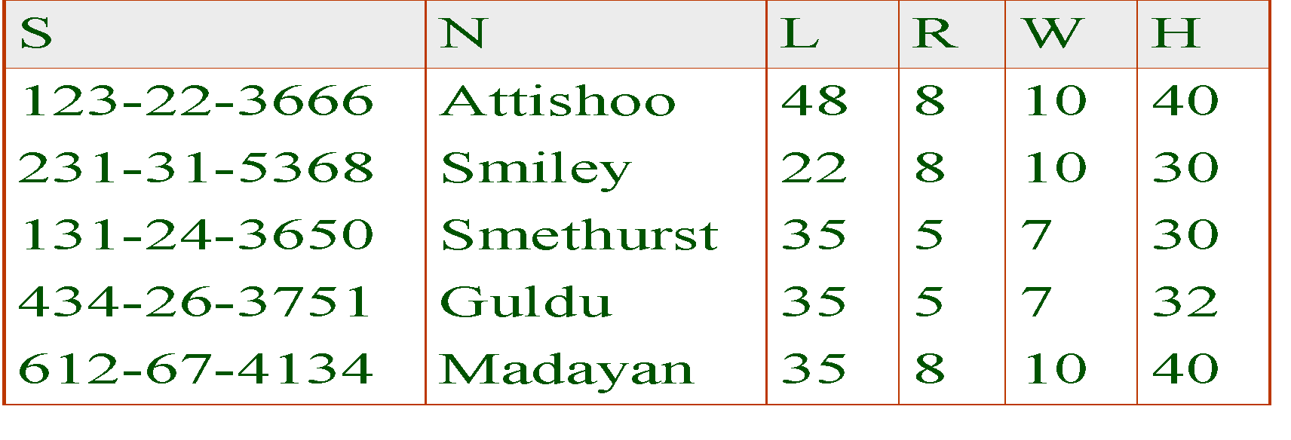
Example: R determines W in table {S,N,L,R,W,H}
Social Security #, Name, Lot, Rating, Wage, Hours per week
FDS S → {S,N,L,R,W,H} AND R → W
Problems due to R → W :
Update anomaly: Can we change W in just the 1st tuple of SNLRWH?
Insertion anomaly: What if we want to insert an employee and don’t know the hourly wage for his rating?
Deletion anomaly: If we delete all employees with rating 5, we lose the information about the wage for rating 5
Functional dependency
Notes:
Consider relation obtained from Hourly_Emps:
Hourly_Emps (ssn, name, lot, rating, hrly_wages, hrs_worked)
Notation: We will denote this relation schema by listing the attributes: SNLRWH
This is really the set of attributes {S,N,L,R,W,H}.
Sometimes, we will refer to all attributes of a relation by using the relation name. (e.g., Hourly_Emps for SNLRWH)
Some FDs on Hourly_Emps:
ssn is the key: S SNLRWH
rating determines hrly_wages: R W

Slide 14
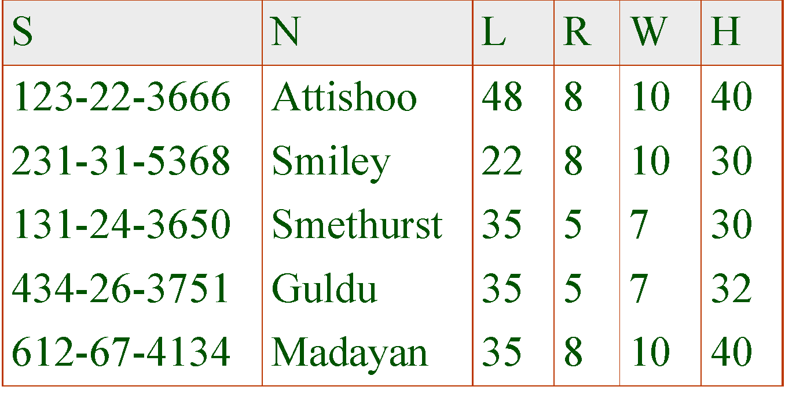
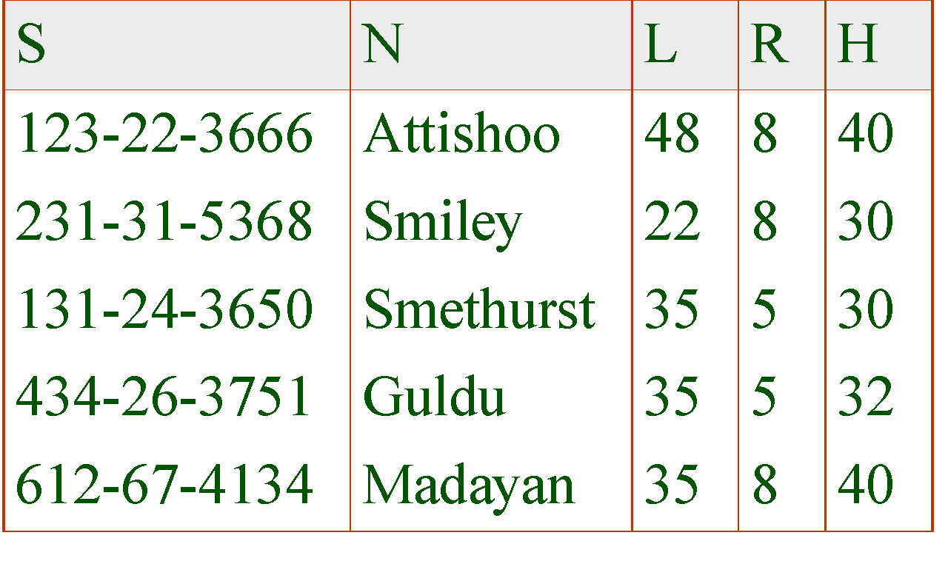
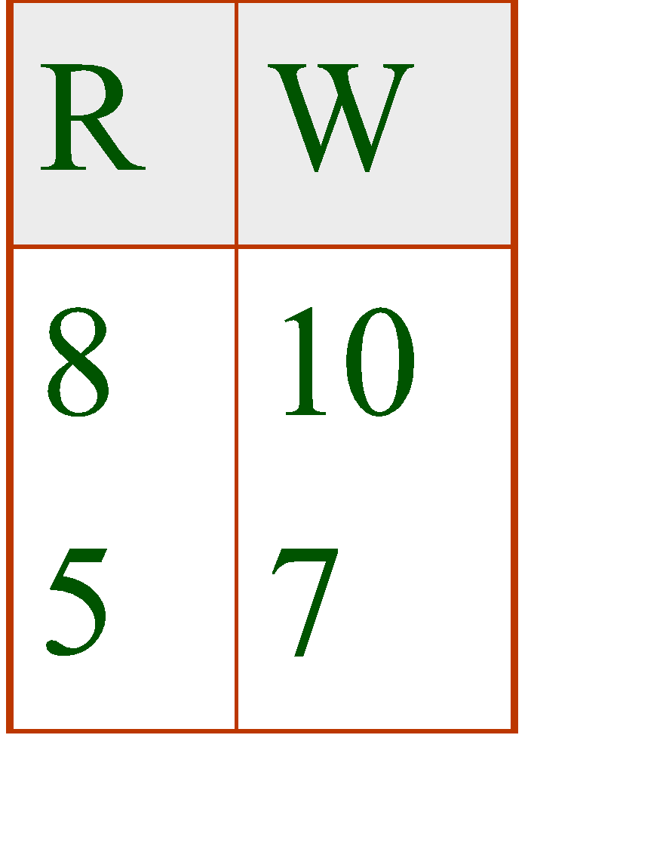
Example Solution
2 smaller tables removes update anomolies
REPLACE:
Hourly_Emps2
WITH:
Wages
Notes:
17

Slide 15
Normal Form: Codd’s Objectives
Free the collection of relations from undesirable insertion, update and deletion dependencies
If schema has duplicated data in multiple rows
Forced to update/delete all copies of a piece of data
How do you know you got all copies of it?
Reduce the need for restructuring the collection of relations
Build an extensible design now as oppose to later
Make the relational model more informative to users
Cleaner model should be easier to understand
Make the collection of relations neutral to the query statistics
Designed for general purpose querying

Slide 16
First Normal Form
Tuples in a relation must contain the same number of fields
The domain of each attribute must be the same
The value of each attribute contains only a single value
No attributes are sets
No repeating groups

Slide 17
Levels of Normal Form
Level 1: No repeating entities or group of elements
Do not have multiple columns representing the same type of entity
Primary key that represents the entity
Example: Table mother (MotherName varchar(40), child1 varchar(20), child2(varchar(20)…child8 varchar(20))
CREATE 3 tables: Mother, Children and Offspring
Offspring links Mother and Children together
OR CREATE 2 tables where the Child relation has a foreign key to the Mother relation

Slide 18
2 table solution
NOT FIRST NORMAL FORM (1NF) – DUPLICATES ENTITIES
Mother Id | Mother Name | Child1 | Child2 | Child3 | Child4
1 | Elsa | Mary | Alice | NULL | NULL
2 | Golda | George | Fred | NULL | NULL
3 | Viola | Ava | NULL | NULL | NULL
4 | Iris | Kayla | NULL | NULL | NULL
5 | Daisy | Harry | NULL | NULL | NULL
Create Table Mother, and a Table Child
Create a foreign key that links Child to Mother
Child Id | Name | Mother
11 | Mary | 1
12 | Alice | 1
13 | George | 2
14 | Fred | 2
15 | Ava | 3
16 | Kayla | 4
17 | Harry | 5
Mother Id | Mother Name
1 | Elsa
2 | Golda
3 | Viola
4 | Iris
5 | Daisy

Slide 19
3 table solution
Mother Id | Mother Name
1 | Elsa
2 | Golda
3 | Viola
4 | Iris
5 | Daisy
NOT FIRST NORMAL FORM (1NF) – DUPLICATES ENTITIES
Mother Id | Mother Name | Child1 | Child2 | Child3 | Child4
1 | Elsa | Mary | Alice | NULL | NULL
2 | Golda | George | Fred | NULL | NULL
3 | Viola | Ava | NULL | NULL | NULL
4 | Iris | Kayla | NULL | NULL | NULL
5 | Daisy | Harry | NULL | NULL | NULL
Offspring Id | Offspring Name
11 | Mary
12 | Alice
13 | George
14 | Fred
15 | Ava
16 | Kayla
17 | Harry
Create Table Mother, Table Offspring and a Table Children
Link them together via a unique representation (social security number)
Parent Id | Offspring Id
1 | 11
1 | 12
2 | 13
2 | 14
3 | 15
4 | 16
5 | 17

Slide 20
Benefits of 1NF
Minimize duplicated data
Beneficial when you want to extend your database by adding more concepts
Example: Say you now want to model the father relationship ?
With the unnormalized NF solution you are forced to duplicate all of the offspring data in the father relation

Slide 21
Adding the Father Relation
NOT FIRST NORMAL FORM (1NF) – DUPLICATES ENTITIES
Mother Id | Mother Name | Child1 | Child2 | Child3 | Child4
1 | Elsa | Mary | Alice | NULL | NULL
2 | Golda | George | Fred | NULL | NULL
3 | Viola | Ava | NULL | NULL | NULL
4 | Iris | Kayla | NULL | NULL | NULL
5 | Daisy | Harry | NULL | NULL | NULL
Forced to duplicate child data in both mother and father relationship
Leads to errors in child data during updates and deletions
Hard to query child data
Limits schema
5 children?
NOT FIRST NORMAL FORM (1NF) – DUPLICATES ENTITIES
Father Id | Father Name | Child1 | Child2 | Child3 | Child4
21 | Sam | Mary | Alice | Fred | NULL
22 | Sal | George | NULL | NULL | NULL
23 | Hal | Ava | NULL | NULL | NULL
24 | Ed | Kayla | NULL | NULL | NULL
25 | George | Harry | NULL | NULL | NULL

Slide 22
1NF with Father Relation
Father Id | Father Name
21 | Sam
22 | Sal
23 | Hal
24 | Ed
25 | George
Mother Id | Mother Name
1 | Elsa
2 | Golda
3 | Viola
4 | Iris
5 | Daisy
Family Table contains
Mapping between mother and offspring and father and offspring
Offsring Id | Name | Father | Mother
11 | Mary | 1 | 21
12 | Alice | 1 | 21
13 | George | 2 | 22
14 | Fred | 2 | 21
15 | Ava | 3 | 23
16 | Kayla | 4 | 24
17 | Harry | 5 | 25

Slide 23
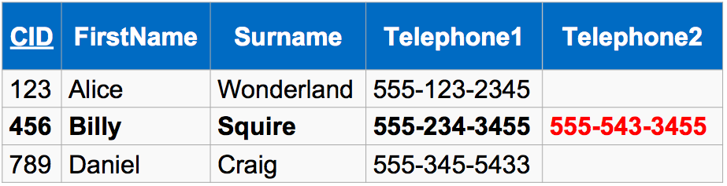
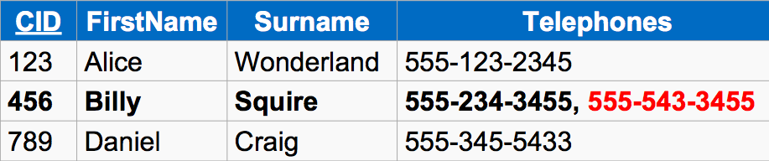
Another 1NF Example
Notes:
Phone numbers in separate columns or in same field TELEPHONE(S)

Slide 24
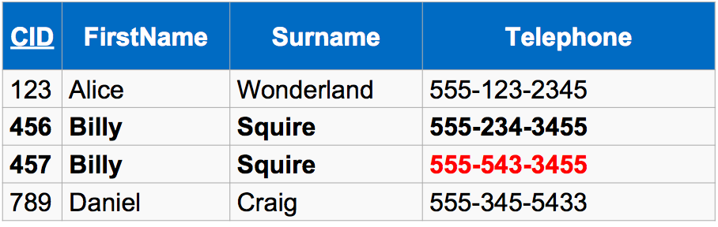
Achieving 1NF
⇒ Redundancy

Slide 25
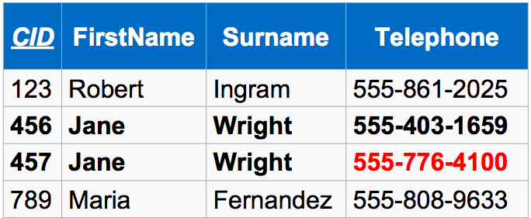
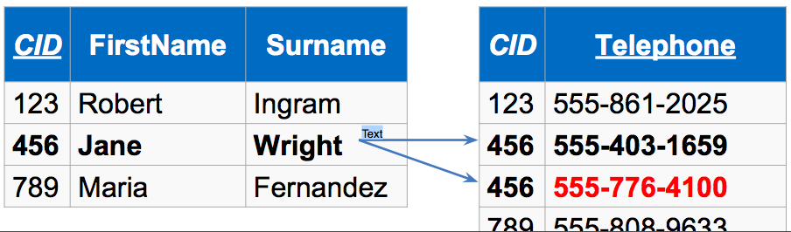
Achieving 1NF
Remove redundant rows
⇒ Redundancy

Slide 26
Second normal form
Schema must be in first normal form
You have eliminated group sets
Every tuple has a unique key
Each field not in the primary key provides a fact about the entity represented via the (entire) primary key
The primary key must be minimal – no extra fields
No partial dependency on the primary key (applies to composite primary key)
Helps you identify a relation that may represent more than one entity
All fields must be functionally dependent on the complete primary key

Slide 27
Example 2NF vs. Not 2NF
1st Normal Form but NOT 2ndNORMAL FORM
Mother Id | First Name | Last Name | Hospital | Hospital Address
1 | Elsa | General | BIDMC | Boston
2 | Golda | Major | MGH | Boston
3 | Viola | Funt | TMC | Cambridge
4 | Iris | Batter | BIDMC | Brighton
5 | Daisy | Mae | Mayo | Allston
2nd NORMAL FORM
Mother Id | First Name | Last Name | Hospital Id
1 | Elsa | General | 1
2 | Golda | Major | 2
3 | Viola | Funt | 3
4 | Iris | Batter | 1
5 | Daisy | Mae | 4
 | 2nd NORMAL FORM
Hospital ID | Hospital | Hospital Address
1 | BIDMC | Boston
2 | MGH | Boston
3 | TMC | Cambridge
4 | Mayo | Allston
Notes:
Remove Attributes (Fields) which are dependent on one part of the Key only

Slide 28
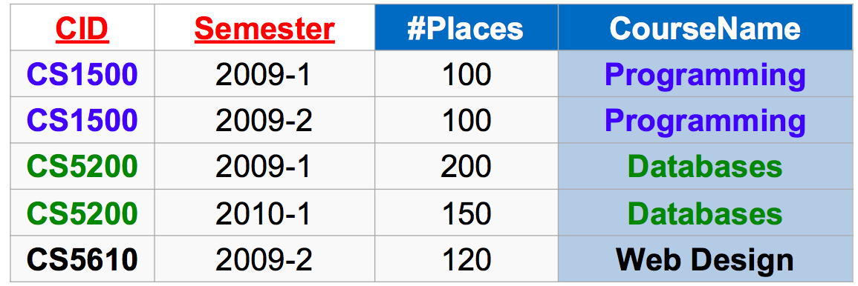
Another 2NF Example
CourseName does NOT depend on the whole PK; only on part of the keys CID

Slide 29
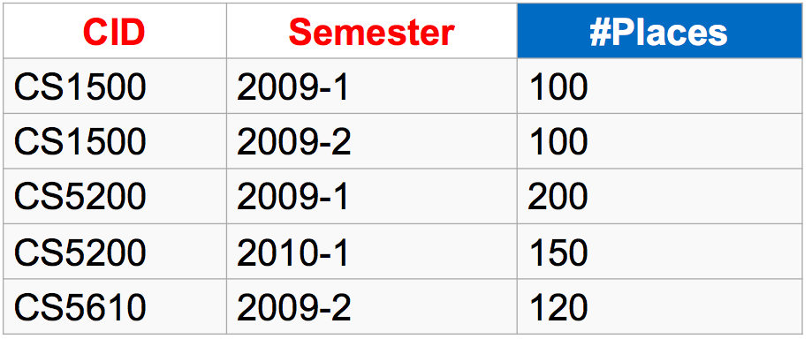
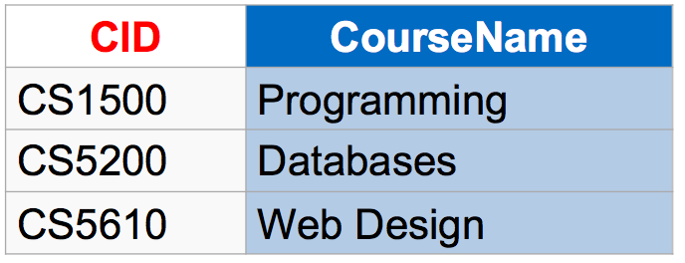
Achieving 2NF
Notes:
1NF : No multivalued attributes
2NF: No partial dependencies + 1NF
3NF: No transitive dependencies + 2NF

Slide 30
3rd Normal Form
No dependencies between 2 non-key attributes
Typically the form most database developers strive to be at
Bill Kent quote:
Every non-key attribute must provide a fact about the key, the whole key and nothing but the key
Notes:
Example between Rating and Wage

Slide 31
Example 3NF vs. Not 3NF (but 2NF)
2nd NORMAL FORM
Mother Id | First Name | Last Name | Hospital Id | Room Number
1 | Elsa | General | 1 | 36
2 | Golda | Major | 2 | 48
3 | Viola | Funt | 3 | 36
4 | Iris | Batter | 1 | 41
5 | Daisy | Mae | 4 | 32
2nd or 3rd NORMAL FORM
Hospital ID | Hospital | Hospital Address
1 | BIDMC | Boston
2 | MGH | Boston
3 | TMC | Cambridge
4 | Mayo | Allston
3rd NORMAL FORM
Mother Id | First Name | Last Name | Registration Id
1 | Elsa | General | 1
2 | Golda | Major | 2
3 | Viola | Funt | 3
4 | Iris | Batter | 4
5 | Daisy | Mae | 5
3rd Normal Form
Registration Id | Hospital Id | Room Id
1 | 1 | 36
2 | 2 | 48
3 | 3 | 36
4 | 1 | 41
5 | 4 | 32
Notes:
Remove Attributes (Fields) which are dependent on another attribute which is not the Key
2nd normal form has mother table with hospital data and room number and the hospital table
3rd normal form pulls out the room number from the mother table

Slide 32
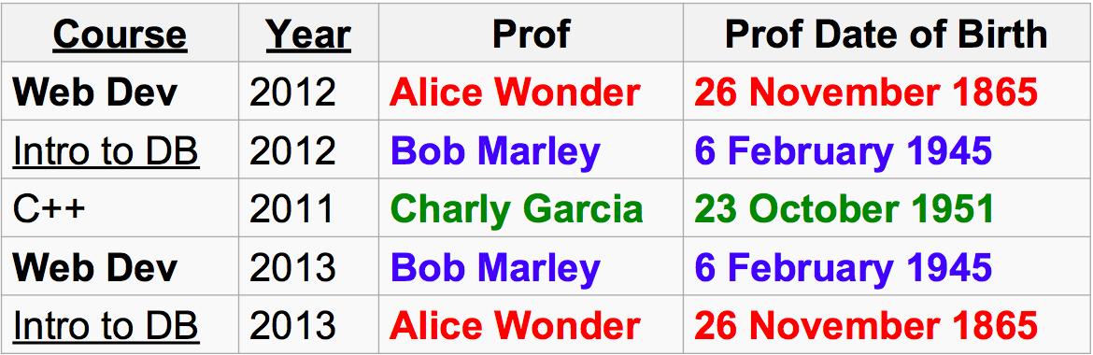
Another 3NF Example
Every non-key attribute must provide a fact about the key, the whole key and nothing but the key!!

Slide 33
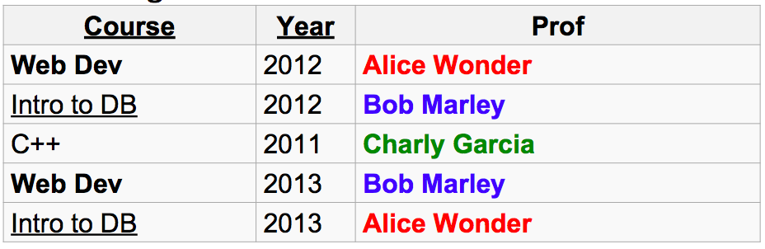
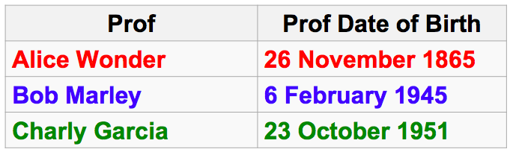
Achieving 3NF

Slide 34
Normal Form Tips
Review your attributes in your tables and ensure that they are facts about the complete key and only the complete key
No duplicating groups in a table
Split many to many relationships up into 2 many to 1 relationships by identifying the relation that maps them together

Slide 35
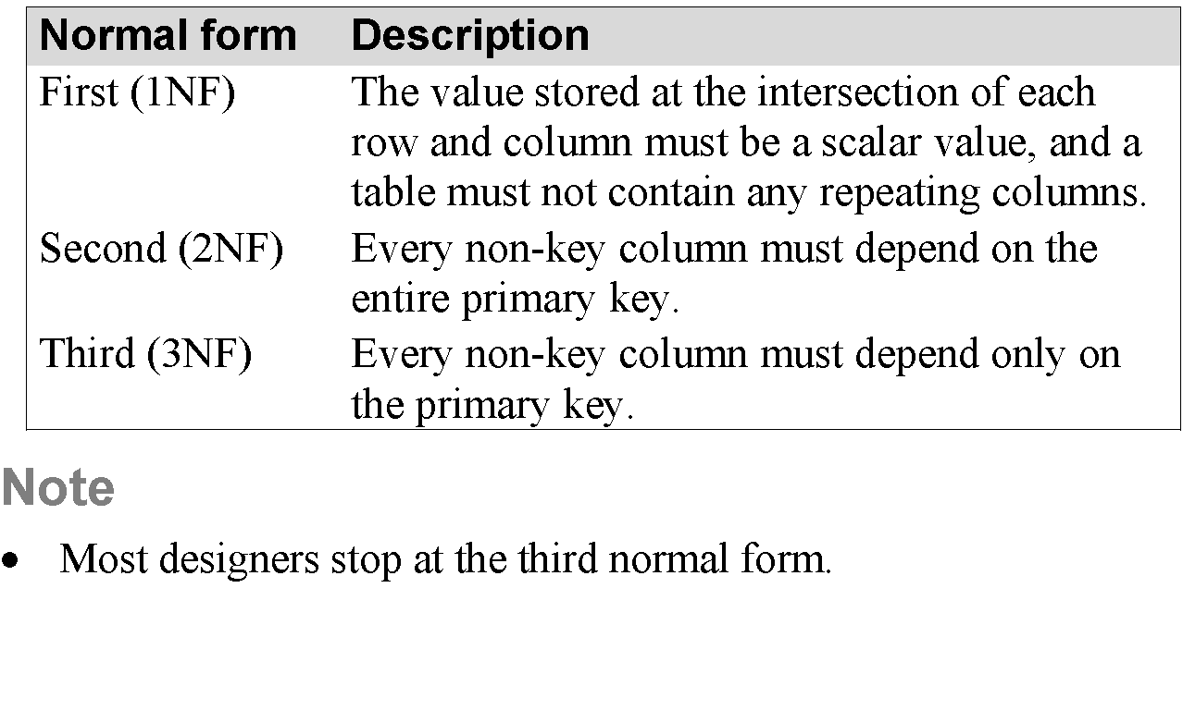
Normal Form Summary

Slide 36
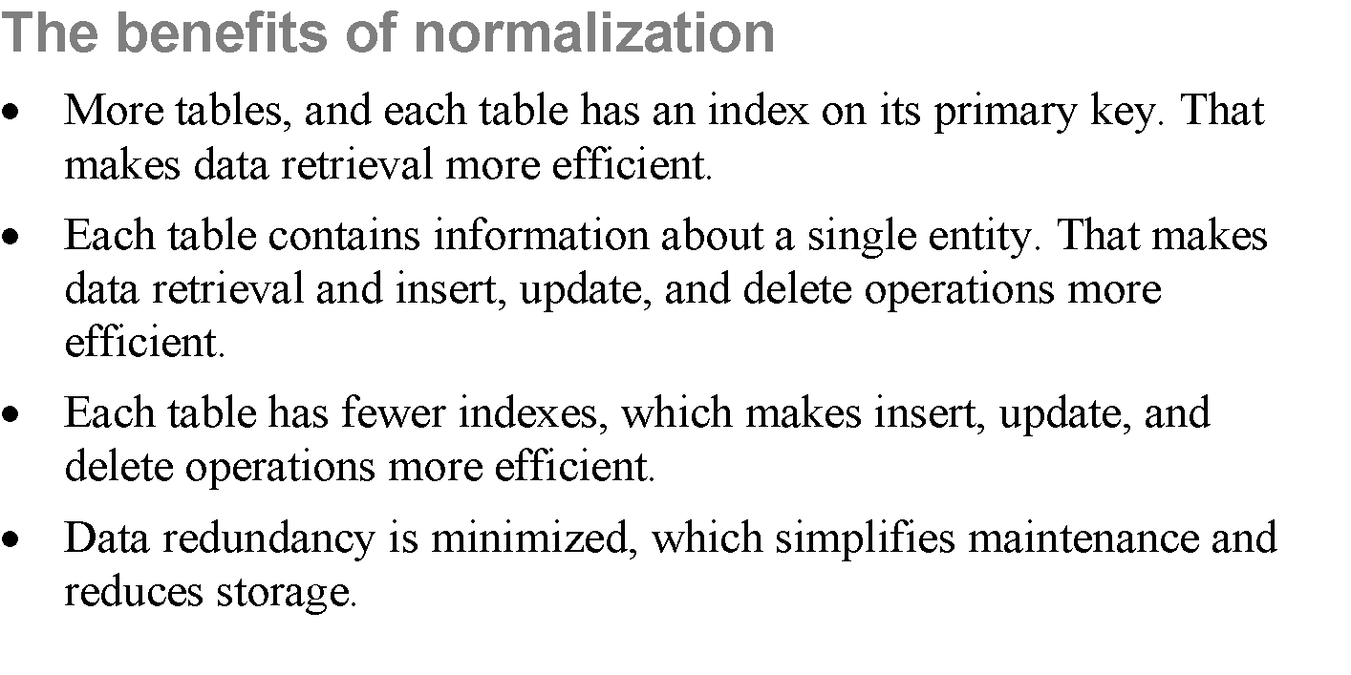

Slide 37
MODEL TO SQL SCHEMA

Slide 38
Example to model
A university consists of a number of departments. Each department offers several majors. A number of courses make up each major. Students declare a particular major and take courses towards the completion of that major. Each course is taught by a lecturer from the appropriate department, and each lecturer tutors a group of students

Slide 39
Example: Entities
A university consists of a number of departments. Each department offers several majors. A number of courses make up each major. Students declare a particular major and take courses towards the completion of that major. Each course is taught by a lecturer from the appropriate department, and each lecturer tutors a group of students

Slide 40
Entities
How do we add:
Department offers several majors
Student
Course
Dept
Lecturer
Univer.
Major

Slide 41
Relationships
How do we add relationships:
Department offers several majors
Course
Offers
Dept.
Student
Lecturer
Univer.
Major

Slide 42
Model to SQL Tables?
Identify the tables for the entities
Identify the tables for the relationships
Identify the table name, field names and data types
Identify the primary keys
Identify the foreign keys
Determine behavior for DELETE/UPATE operations
Represent other column and table constraints
NULL allowed for field?
Default value for a field?

